Slide 1








BRIGHTtv
ELISA MACAMO

Slide 2
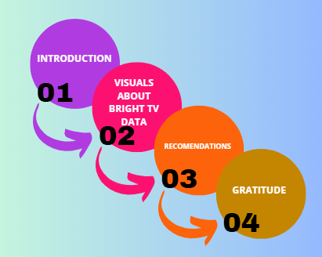
WHAT TO EXPECT!

Slide 3
ESSENTIAL INSIGHTS OF THE BRIGHTTV DATA
AGE
DURATION OF THE VIEWERSHIP
USERID
PROVINCES
RECORD DATE
GENDER
RACE
TV CHANNELS

Slide 4
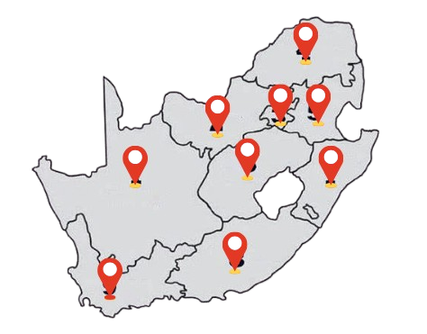
WHO ARE YOUR VIEWERS?
TOTAL VIEWERS:
10989
VIEWERS ARE IN ALL SA PROVINCES.
VARIOUS AGE GROUPS AND DIFFERENT VIEWED CHANNELS.

Slide 5
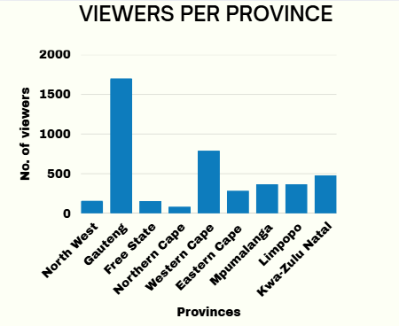
WHO ARE YOUR VIEWERS?
GAUTENG LEADS WITH HIGHEST NO. OF VIEWERS

Slide 6
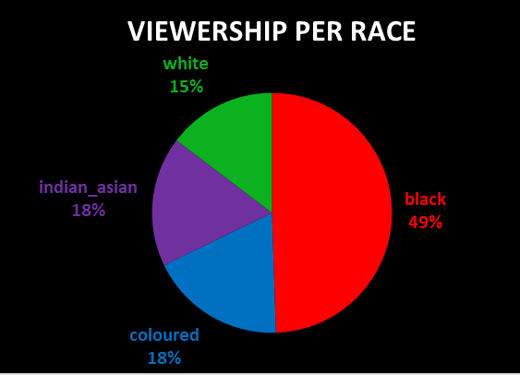
WHO ARE YOUR VIEWERS?
BLACKS FORM THE LARGEST GROUP OF VIEWERS

Slide 7
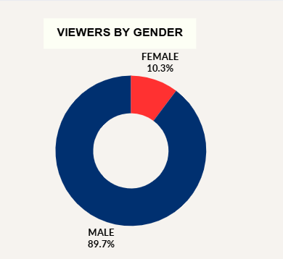
WHO ARE YOUR VIEWERS?
MALE VIEWERS DOMINATE ACROSS ALL SA PROVINCES

Slide 8
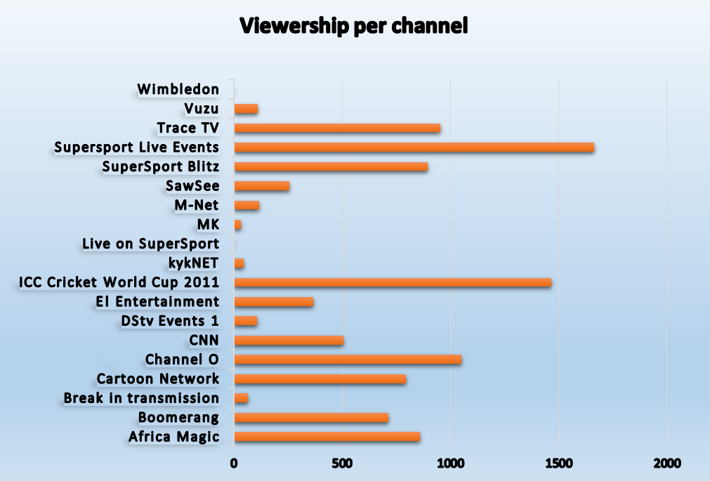
CHANNEL VIEWERSHIP
19
CHANNELS
SUPERSPORT LIVE EVENTS IS THE
MOST WATCHED CHANNEL

Slide 9
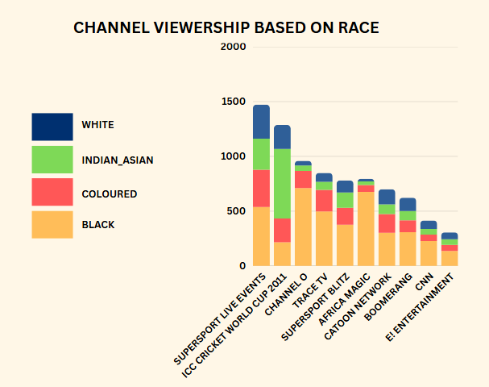

TOP 10 CHANNELS BY VIEWS AND RACE
SUPERSPORT LIVE EVENTS HAS ALMOST THE SAME NO. OF VIEWERS AMONGST ALL THE RACES

Slide 10
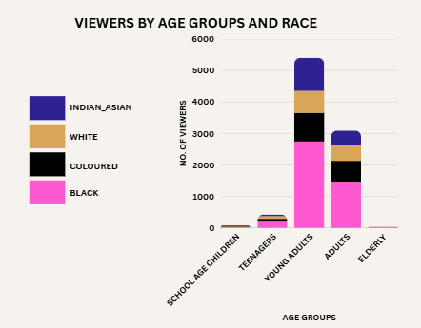
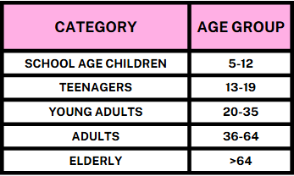
AGE GROUPS VS RACE
YOUNGEST:
9 YRS OLD
OLDEST:
114 YRS OLD

Slide 11
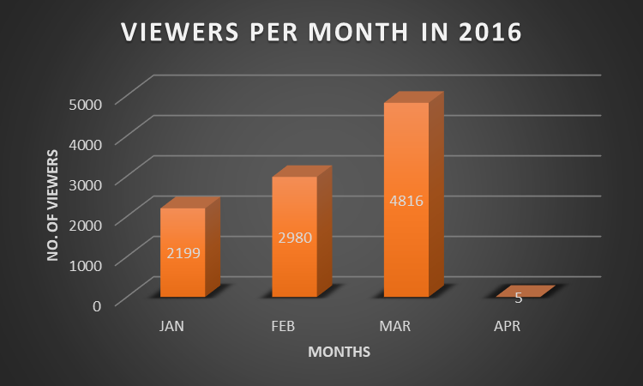
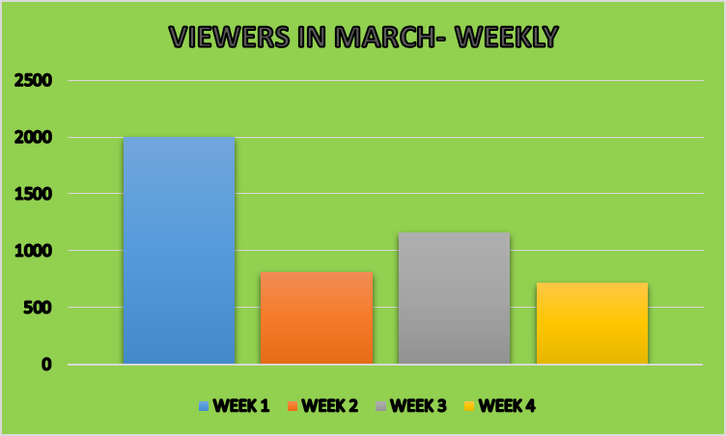
VIEWERSHIP WITHIN 4 MONTHS
AVERAGE VIEWING TIME :
9.14 MINS
MARCH HAS THE HIGHEST VIEWERSHIP

Slide 12
FACTORS INFLUENCING CONSUMPTION
SUBSCRIPTION COSTS
DEVICE COMPATIBILITY (ABILITY TO WATCH ON VARIOUS DEVICES)
DATA CONSUMPTION CAN INFLUENCE WHEN AND HOW VIEWERS CONSUME CONTENT.
VARIOUS AGE GROUPS HAVE DISTINCT VIEWING PREFERENCES AND HABITS
SCHEDULING STRATEGIES THAT FAIL TO ACCOMMODATE OTHER VIEWERS.
RECOMMENDATIONS
BRING CELEBRITIES OR INFLUENCERS WHO RESONATE WITH THE TARGET AUDIENCE.
POLLS AND GAMES WHERE AUDIENCE VOTE ON OUTCOMES OR PARTI[PATE VIA APPS OR SOCIAL MEDIA.
INCREASE MORE INTERESTING CONTENT FOR THE KIDS AND TEENANGERS.
LIVE Q&A SESSION WHERE VIEWERS CAN SEND IN QUESTIONS.

Slide 13
KEY FINDINGS
GAUTENG HAS THE HIGHEST VIEWER CONCENTRATION ACROSS SA.
MALE AND BLACK AUDIENCES DOMINATE VIEWERSHIP DEMOGRAPHICS.
SUPERSPORT LIVE EVENTS IS THE MOST POPULAR CHANNEL ACROSS ALL RACES.
AVERAGE VIEWING TIME IS RELATIVELY SHORT AT 9.14 MINUTES.
FINAL THOUGHTS
BRIGHTTV HAS BROAD REACH ACROSS ALL PROVINCES AND DIVERSE AGE GROUPS.

Slide 14


